Slide 1
ByteFourz
Solution for improving packing process
Moinak Ghosh(TL) Sayani Dutta Swarnim Raj Keshav Bagri

Slide 2





The Problems
Large number of moving parts that causes mechanical wear and tear
No way for real-time notification of fault
Fault detection takes time and effort
Time required to service fault increases in the event of unavailability of spares
No availability of data to create fault prediction models

Slide 3
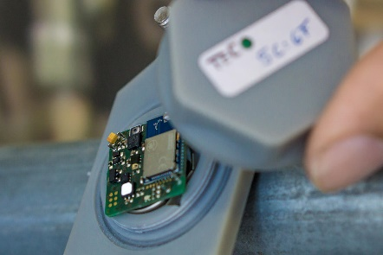

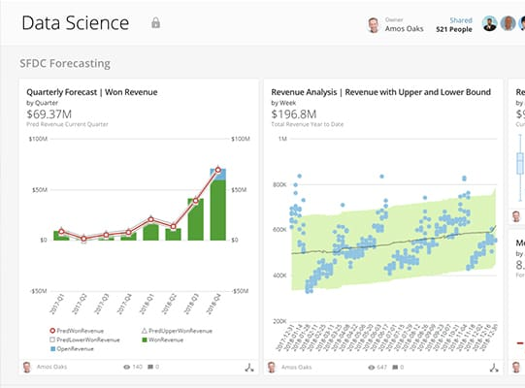

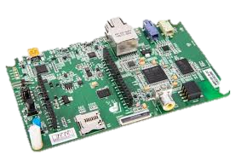
Our Solution
An end to end solution to use assorted sensors to capture fault indication metrics, process that locally on a microcontroller using DSP and Machine Learning algorithms and send the inference data to the cloud for datalogging, anomaly type detection and notifying concerned personnel
Preprocessing and analysis on local processor
Inference data sent to the cloud database
Data further analysed to detect type of anomaly
Concerned Personnel notified
Sensor Data captured

Slide 4
Implementation
Motor Power data analysis
The main moving elements inside the Autopack Sollas packing machine are the servo motors
By analysis of the voltage and current draw of the motors, it can be predicted if there is tolerance in a joint or if the friction has increased due to lack of lubrication or damage to bearings, gears or belts.
Data points sent to the cloud when a threshold is crossed
Data stored in AWS DynamoDB and anomaly detection started
Current draw pattern analysed locally
Notifications
sent
Merits of the solution
Direct mechanism to detect damage to gears, bushings and washers
Detects loss of lubrication at a specific location
Detects fault in motors or any rotating component
Through suitable assemblies, can be used for linear actuators
Indirect method to detect electrical faults as well

Slide 5
Implementation
Vibration data analysis
Vibration patterns of the Sollas Packing machine would be monitored to predict mechanical attachment faults or tolerances in linear actuators. The signal would also be downsampled and sent to the cloud for logging along with the inference drawn about the vibration pattern.
Data points sent to the cloud when a threshold is crossed
Data stored in AWS DynamoDB and anomaly detection started
Vibration pattern analysed locally
Notifications
sent
Merits of the solution
Direct mechanism to detect damage to moving parts
Detects tolerances in precision equipment
Low-cost, non-invasive and portable attachment

Slide 6
Implementation
Gateway and Cloud interface
The processed data points from the microcontroller would be logged on the AWS Dynamo DB from where the data would be queried and further analysed using AWS Lambda scripts.
Relevant notifications are sent to all stakeholders with action items and inventory data
Data logged is used for creating a digital twin of machine
Inference data sent by microcontroller
Gateway sends data to AWS IoT cloud
AWS Lambda scripts detect anomaly
Notifications on dashboard and on phone received
Datalogs stored in AWS DynamoDB
Inventory queried for spares and shortages flagged
Merits of the solution
Immediate fault notification sent through Cloud app
Notification sent to concerned personnel about expected replacements
Automated inventory queries help managers line up repairs quicker
Data logged is useful in making models to predict similar faults in future

Slide 7
Cost Analysis
Item | Quantity | Price
Vibration Sensor | 1 | 1400
ARM Cotex M7 microprocessor unit | 1 | 2000
Network connection controller(gateway) | 1 | 400
Battery and charging circuit | 1 | 50
Cabling and mechanical attachments | - | 200
Mechanical Enclosure Development(IP67) | 1 | 400
Recurring Cloud database fees | - | 1500*
TOTAL |  | 5950
*https://aws.amazon.com/iot-core/pricing/

Slide 8
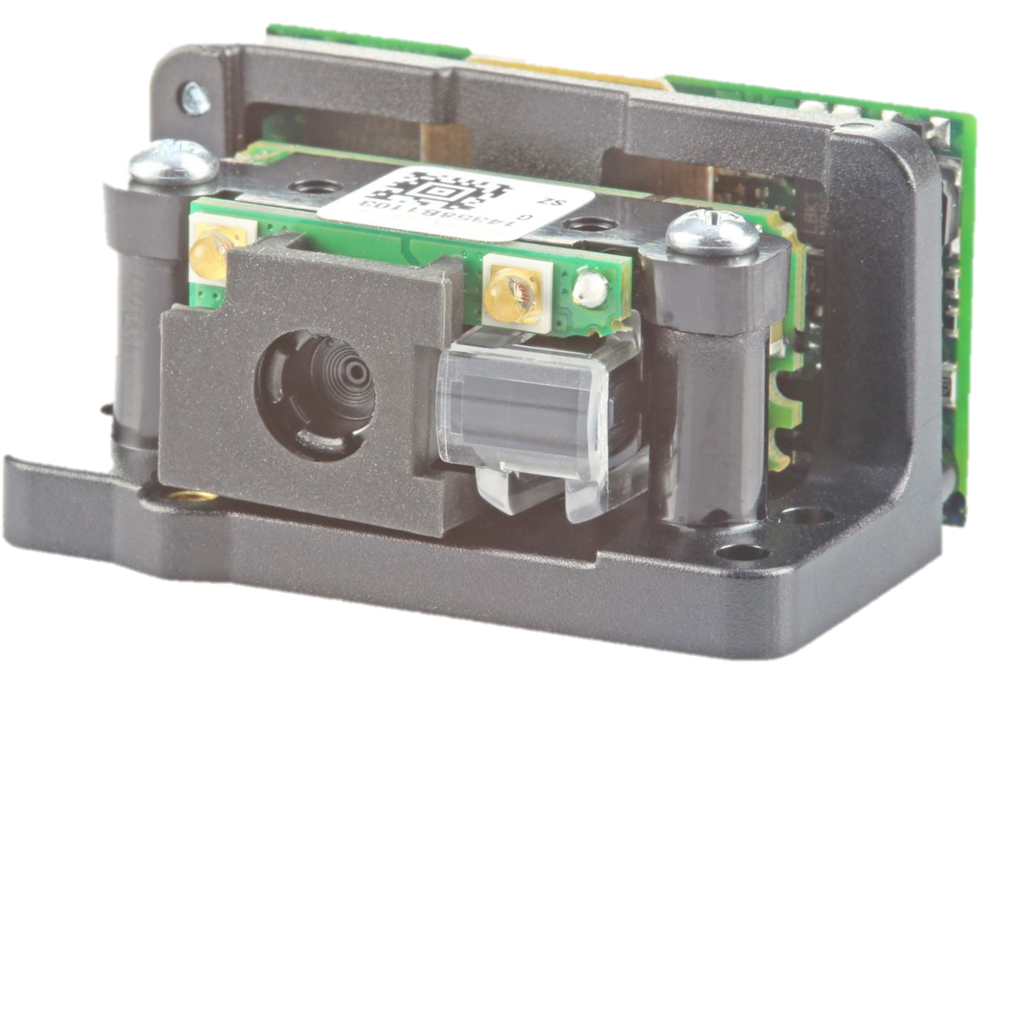
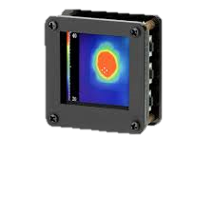
Possible Enhancements
Use of high precision camera for measuring tolerances in packing heads.
Measurement of temperature of heat-sealing heads with suitable sensor attachment

Slide 9
Thank You!!

